Slide 1



ABAP on Hana s/4 Hana Training
Day 18
contact@anubhavtrainings.com

Slide 2

Agenda – Day 18
Describing SAP Analytics Cloud ( SAC )
Consume CDS in Analytics Cloud
Creating Dashboard’s on top of CDS in Analytics Cloud
Describing Details S/4 HANA Scenario
Creating End to End S/4 HANA Scenario for OVP ( Analytics )
Create your OVP ( Overview page ) UX Elements show Analytical dashboard

Slide 3
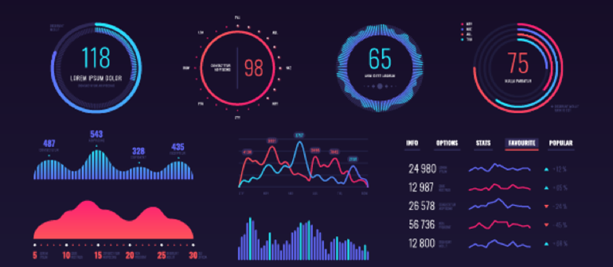
SAP Analytics Cloud ( SAC )
The SAP Analytics Cloud solution combines BI, augmented and predictive analytics, and planning capabilities into one cloud environment. As the analytics layer of SAP's Business Technology Platform, it supports advanced analytics enterprise-wide.
SAP Analytics cloud is a SaaS offering by SAP for complete BI, Planning, Predictive and designer capabilities.

Slide 4
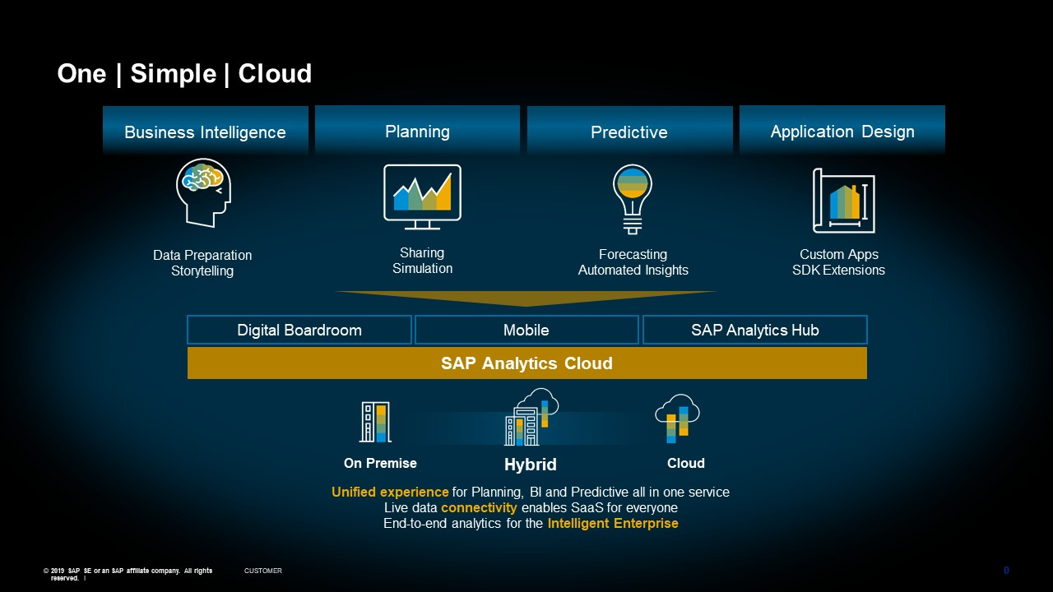
Phases of SAP Analytics Cloud ( SAC )

Slide 5
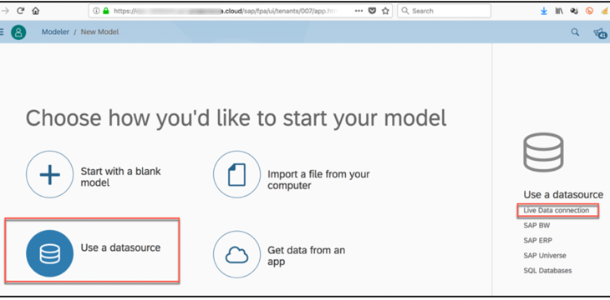

Consume CDS in Analytic Cloud
With Live Data
Connection

Slide 6

Exercise
Consume CDS in Analytics Cloud Code

Slide 7
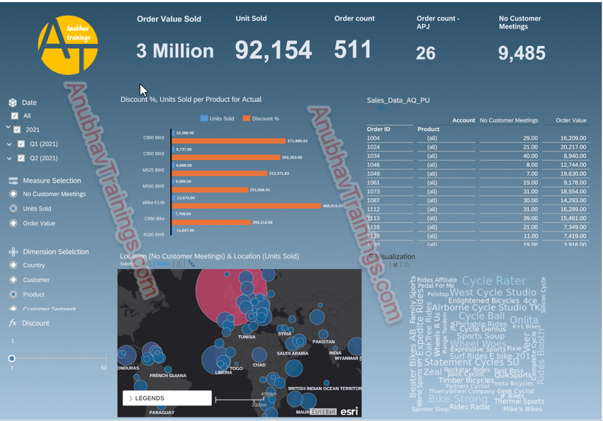
SAC Dashboard on top of CDS

Slide 8
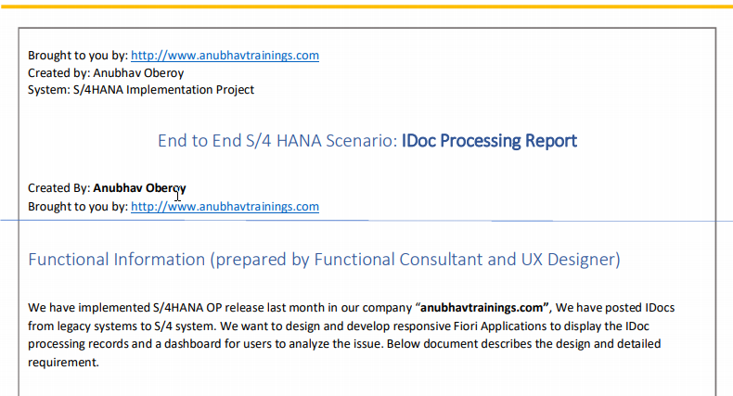
Elaborating End to End S/4 HANA Scenario

Slide 9
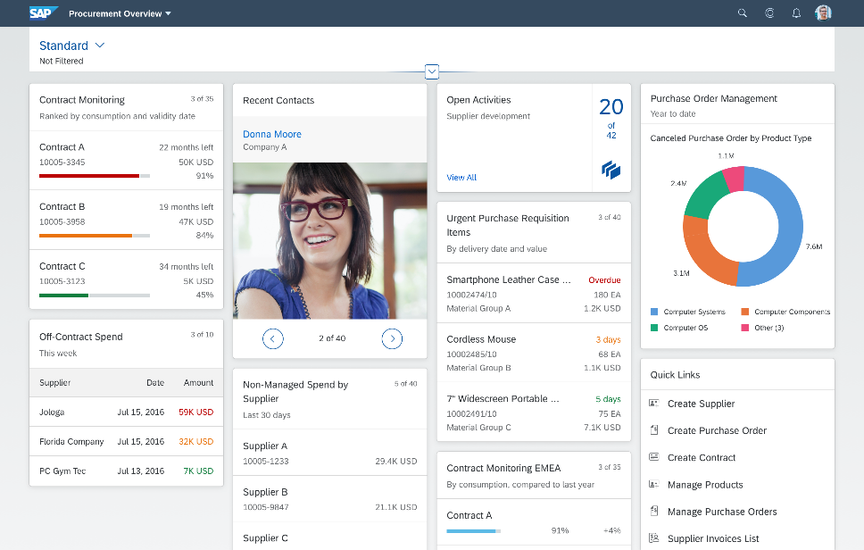
Describing OVP (Overview Page)
Overview pages provide quick access to vital business information at a glance, in the form of visual, actionable cards.
The user-friendly experience makes viewing, filtering, and acting upon data quick and simple. Business users can see the big picture at a glance, and also focus on the most important tasks, enabling faster decision making as well as immediate action.
The displayed data is fully interactive, with clickable areas for easy navigation to relevant applications. Based on SAP Fiori, overview pages organize action items with a fully responsive user interface. Users can access overview pages from SAP Fiori Launchpad and narrow down the information displayed, or opt to hide cards to focus on a particular topic.
The analytical card is a single object card and does not contain a footer area. It can only be used in the overview page (OVP). In the resizable card layout, users can show more content/insights by resizing the card.

Slide 10
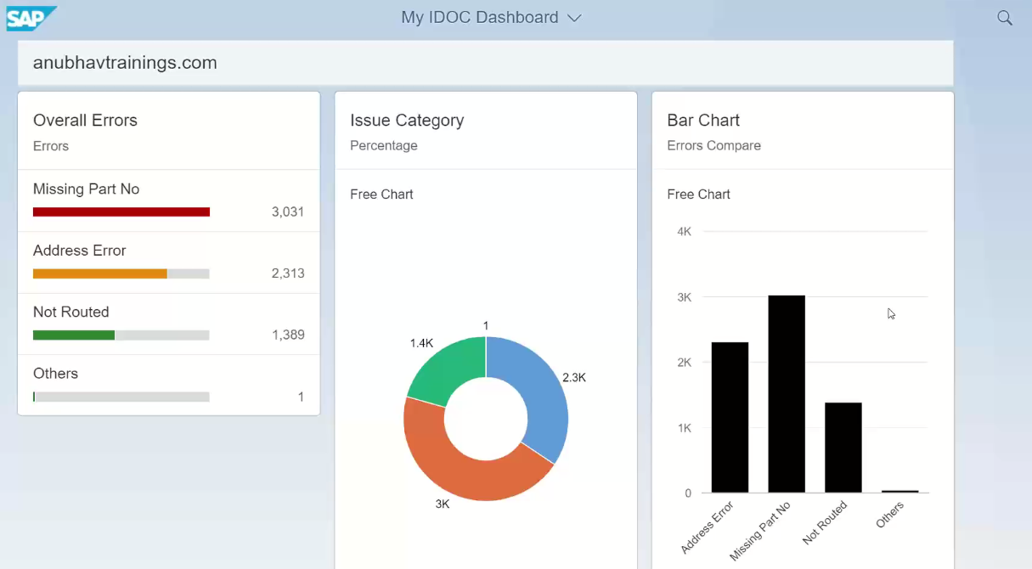
Analytic Dashboard ( OVP )
Analytic Dashboard (OVP) on top of CDS with the help of UI.Annotations ,it Calculate Overall Errors in following Categories of Analytics are Mentioned Below

Slide 11
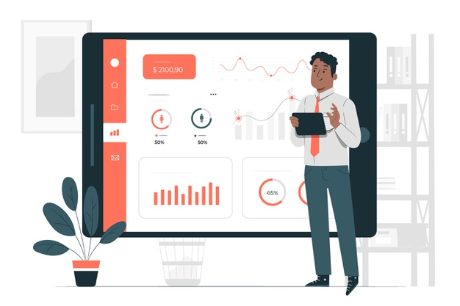
Exercise
End to End S/4 HANA Scenario for Overview Page ( OVP )

Slide 12

End of Day 18
Trainer: Anubhav Oberoy

Slide 13

Trainer: Anubhav Oberoy

Slide 14
THANK YOU
If you cannot do
great things, do small things in a great way.
Anubhav Oberoy
https://www.anubhavtrainings.com

Slide 15


We’re committed to empower you to be
Most Desirable Resource
through powerful training solutions.
We build the workforce of the future.
250+
Corporate Clients
30,000+
Learners Trained
25000+
Learners Placed
FREE WEBINARS
Sign up for free webinars with industry experts every fortnight!
Enroll Now!
Contact us today!
https://anubhavtrainings.com/

Slide 16




More from AnubhavTrainings.com

